Slide 1
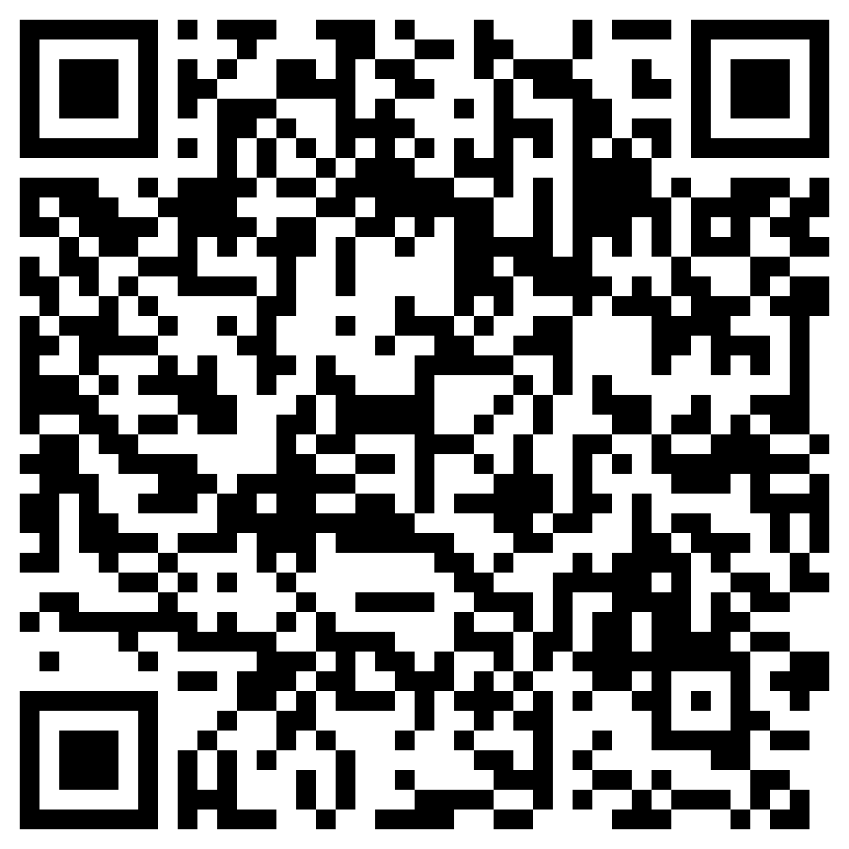
WorldSkills - Cyber Security National Competition 2024
WorldSkills - Cyber Security Skill
Infrastructure set-up and security hardening
Incident response and forensics
Capture the flag (red team activities)
Capture the flag (blue team activities)
Prelim dates (take part in one)
Friday May 31st 4pm - 8pm
Saturday June 1st 9am - 1pm
Competitions
Prelim
National
International
Eligibility
25 years old or younger
Must be studying or working in Ireland

